Slide 1
SOUND DIFFUSING METASURFACES BASED ON ELASTIC PLATES AND MEMBRANES
DIFUSIÓN DEL SONIDO CON METASUPERFICIES BASADAS EN PLACAS ELÁSTICAS Y MEMBRANAS
October, 2021.
José M. Requena-Plens¹, Jean-Philippe Groby², Vicent Romero-García², Noé Jiménez¹
¹ Instituto de Instrumentación para Imagen Molecular, Universitat Politècnica de València - CSIC, València, Spain
² Laboratoire d’Acoustique de l’Université du Mans (LAUM), UMR 6613, Institut d'Acoustique - Graduate School (IA-GS), CNRS, Le Mans Université, Le Mans, France

Slide 2
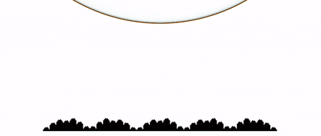
Introduction
Sound diffusers
Sound diffusers are surfaces whose scattering function is uniform, i.e., the reflected waves by these surfaces are dispersed in many different directions.
There are many ways to approach diffuser design to control sound reflection.
arqen.com/sound-diffusers/

Slide 3
Introduction
Sound diffusers
Sound diffusers are surfaces whose scattering function is uniform, i.e., the reflected waves by these surfaces are dispersed in many different directions.
There are many ways to approach diffuser design to control sound reflection.
Phase-grating diffusers [Schroeder JASA 57 (1975)]
  Maximum-Length sequences (MLS) [Schroeder, JASA 57 (1975)]
  Quadratic residue sequence (QRD) [Schroeder, JASA 65 (1979)]
  Primitive root sequence (PRD) [Schroeder, “Number theory in science and communication” (1984)]
ddd
MLS
QRD

Slide 4
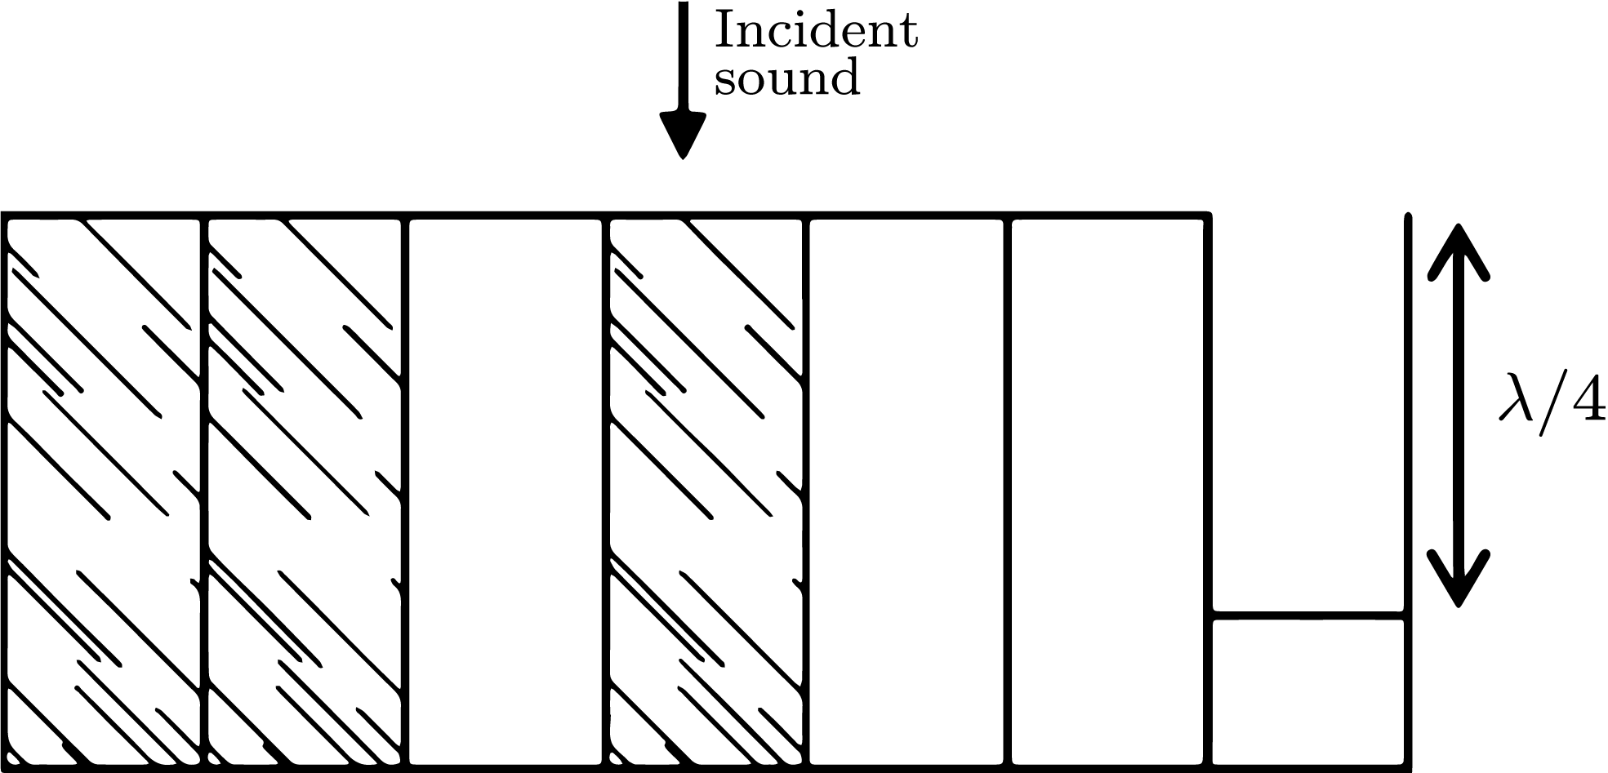
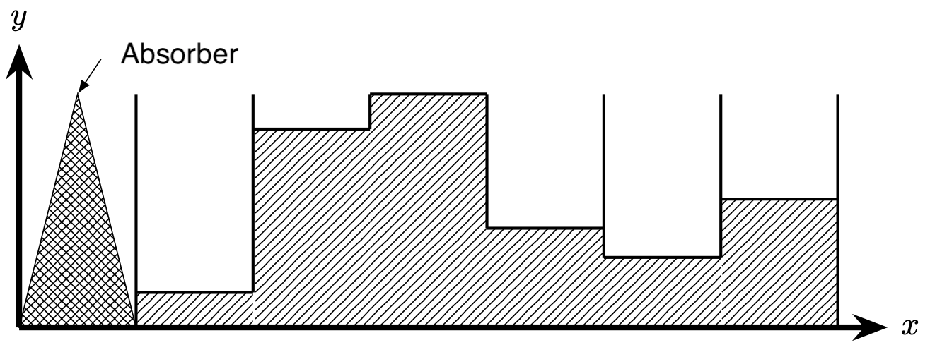
Introduction
Sound diffusers
Sound diffusers are surfaces whose scattering function is uniform, i.e., the reflected waves by these surfaces are dispersed in many different directions.
There are many ways to approach diffuser design to control sound reflection.
Hybrid diffusers
  Index sequences [Schroeder, Acta Acust united Ac 81 (1995)]
  Ternary-Quadriphase sequences [Cox, JASA 119 (2006)]
ddd
Index
Ternary [Cox, JASA 119 (2006)]

Slide 5
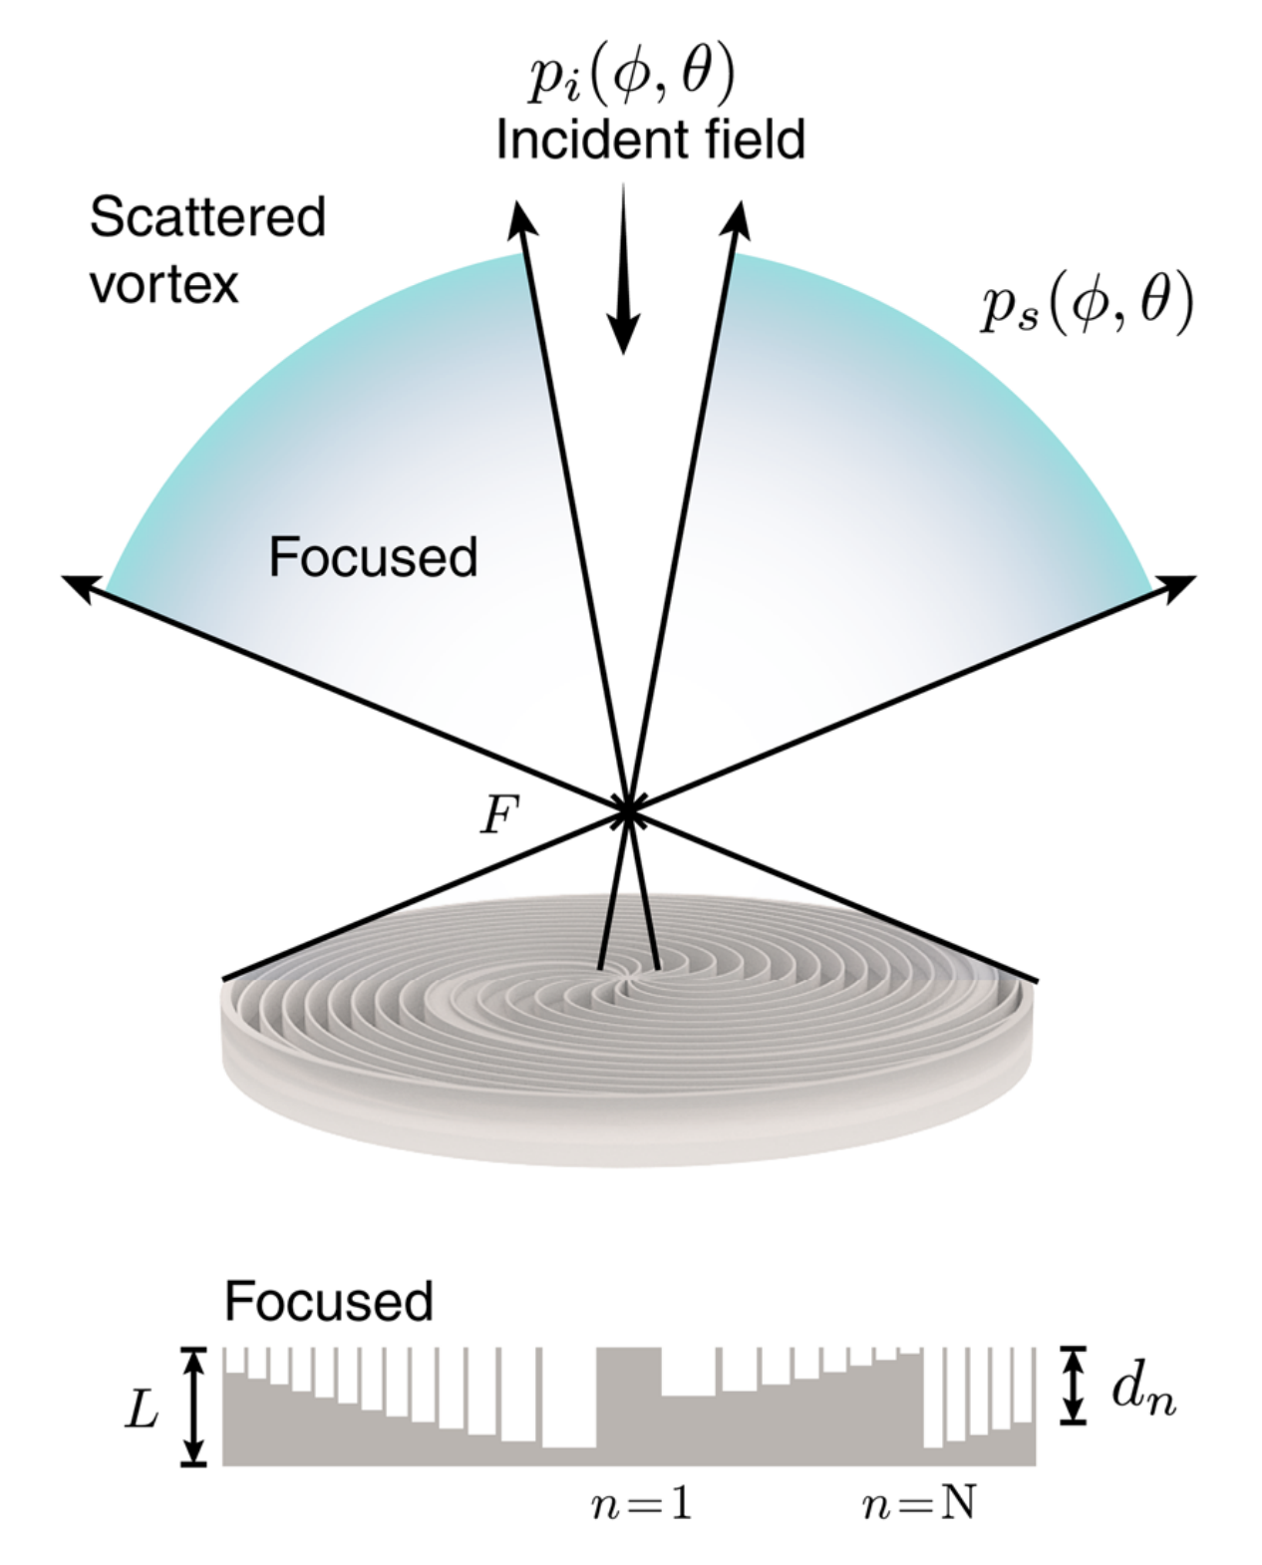
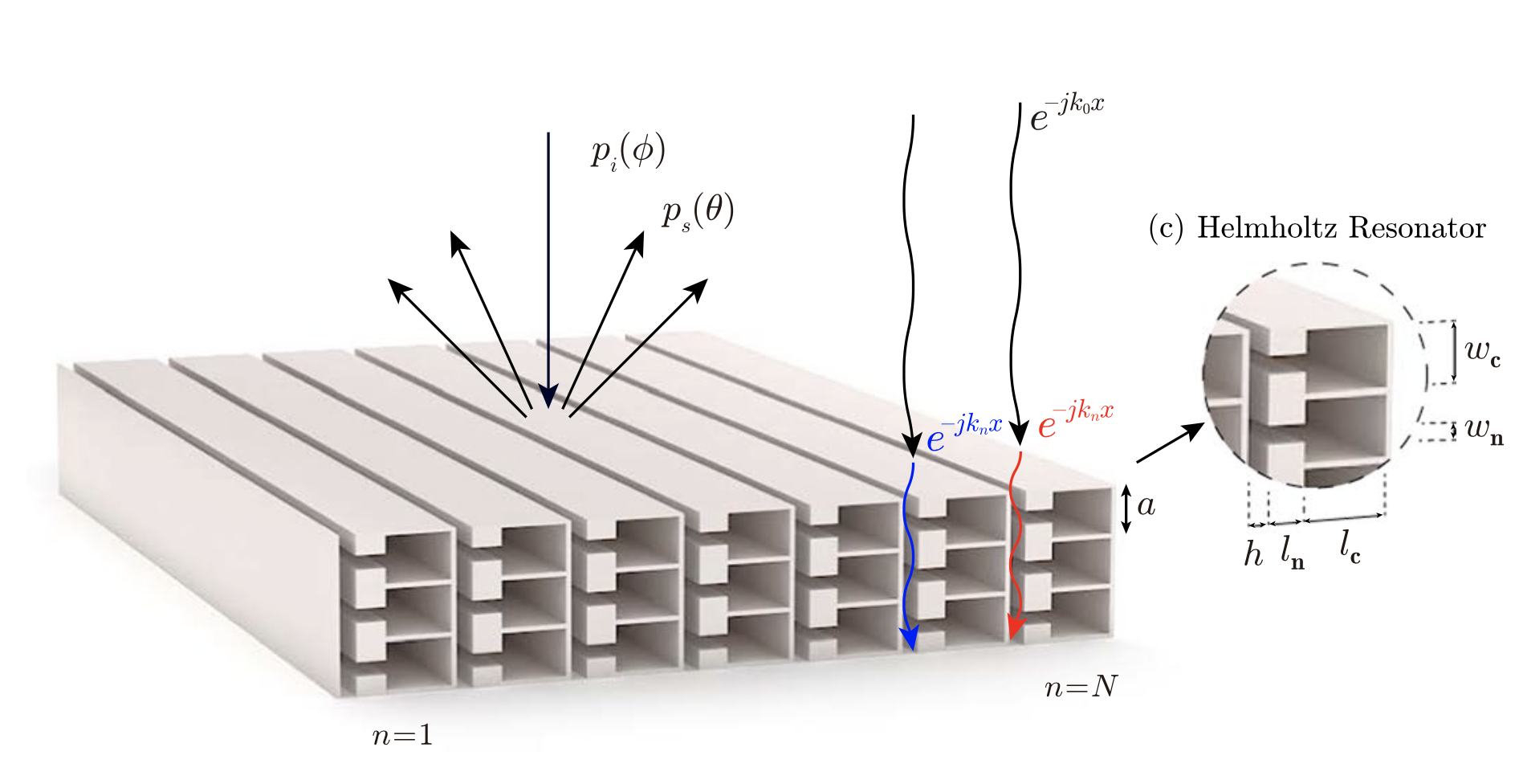
Introduction
Sound diffusers
Sound diffusers are surfaces whose scattering function is uniform, i.e., the reflected waves by these surfaces are dispersed in many different directions.
There are many ways to approach diffuser design to control sound reflection.
Metadiffusers
  Based on Helmholtz resonator [Jiménez, Sci. Rep. 7 (2017)]
  Based on holographic vortices [Jiménez, Sci. Rep. 11 (2021)]
Helmholtz [Jiménez, Sci. Rep. 7 (2017)]
Vortices [Jiménez, Sci. Rep. 11 (2021)]

Slide 6
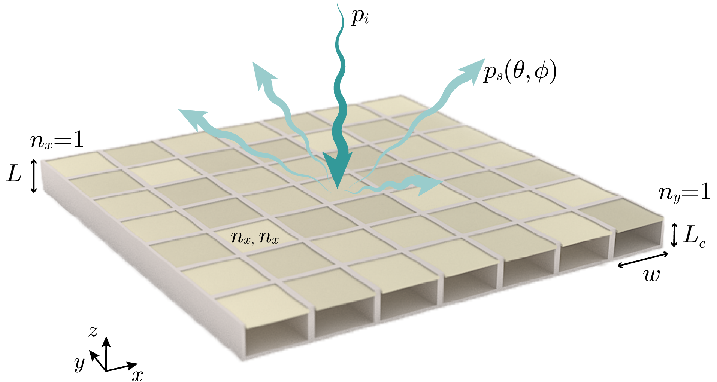
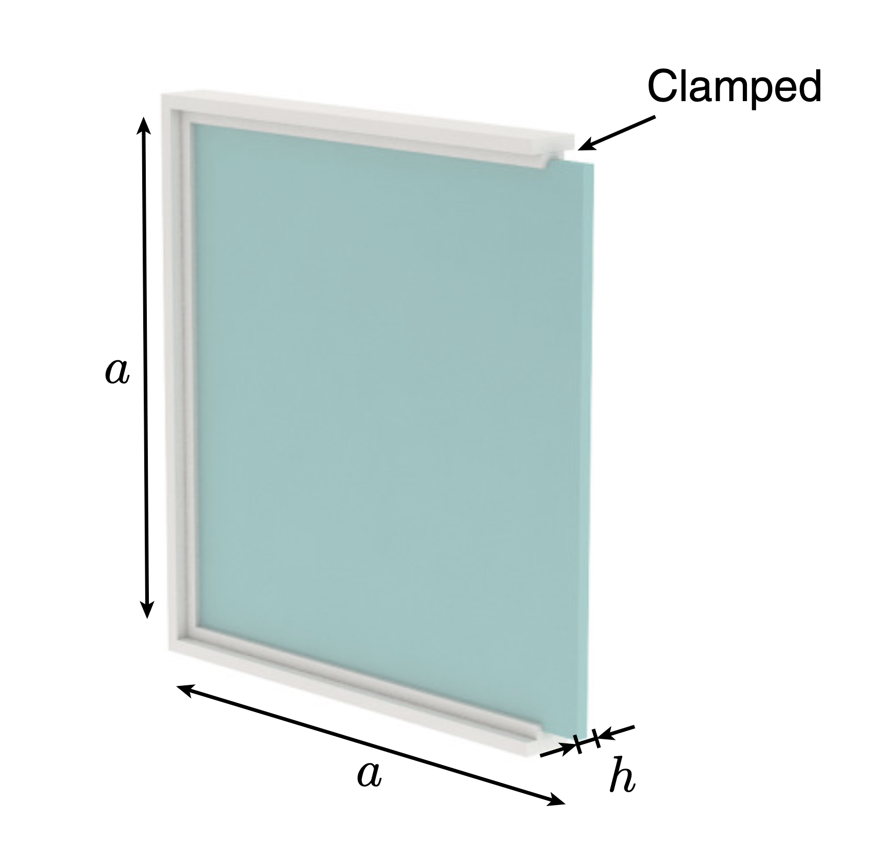

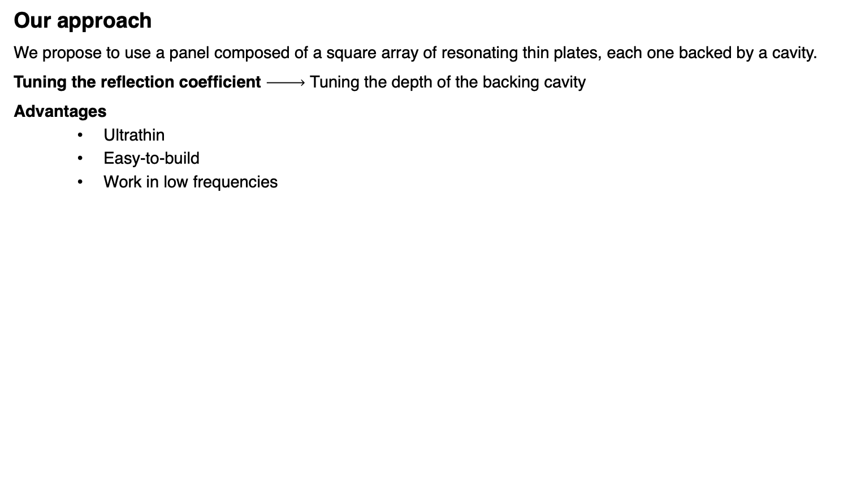
Introduction
Our approach
We propose to use a panel composed of a square array of resonating thin plates, each one backed by a cavity.
Tuning the reflection coefficient Tuning the depth of the backing cavity
Advantages
  Ultrathin
  Easy-to-build
  Work in low frequencies

Slide 7
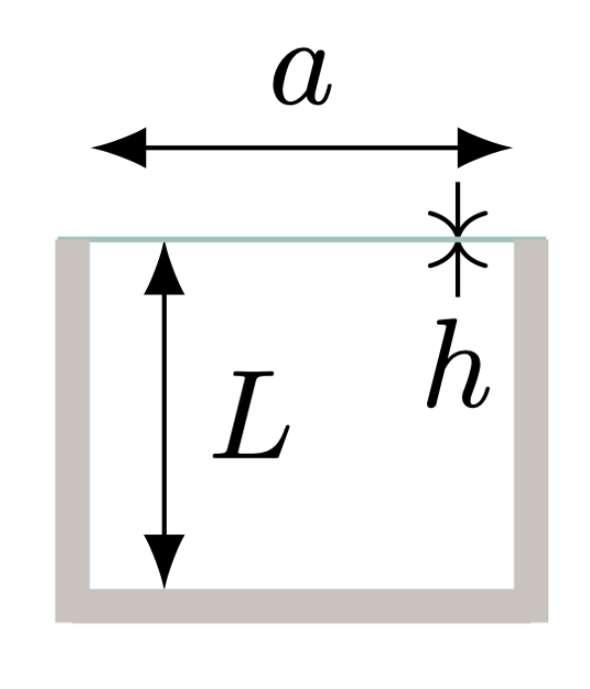
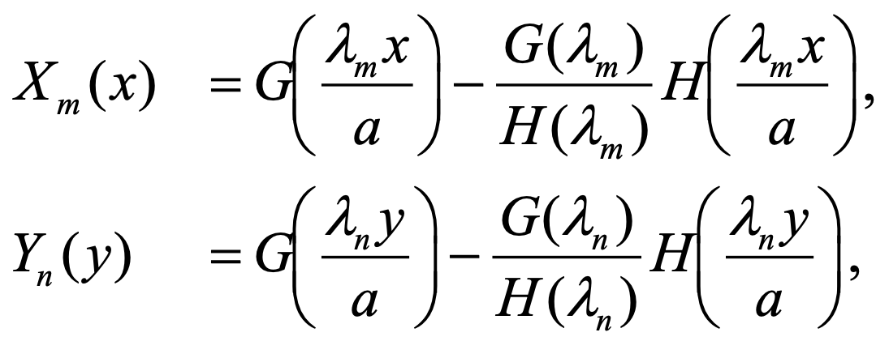
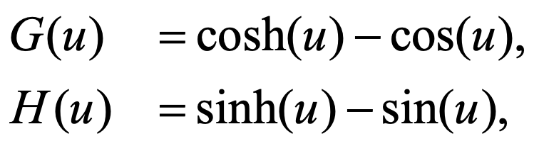
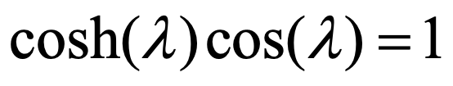
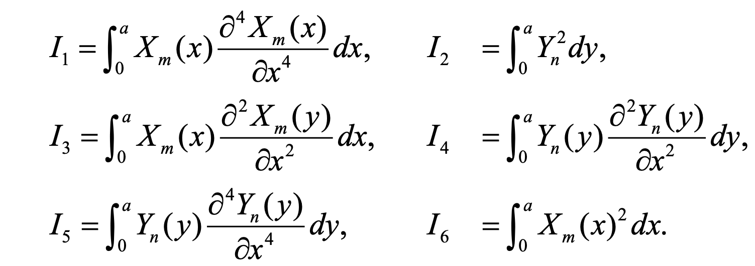
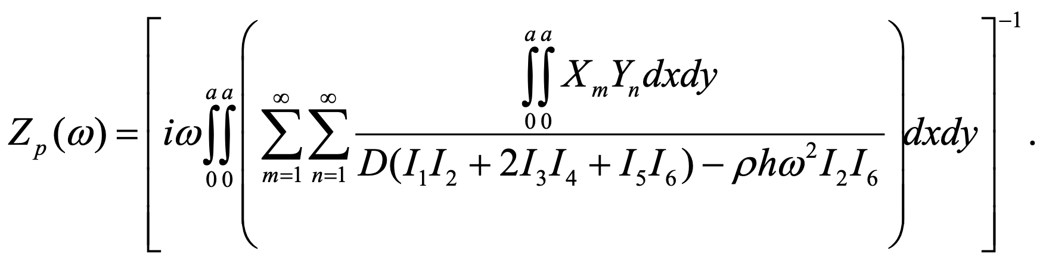
Methods
Model of unit cell
Clamped square elastic plate backed by a cavity
Impedance of square elastic plate [Sun and Yang, JSV 207 (1997)]
Modal decomposition:
Numerical solution [Simpson]: Plate impedance:
[Muller (1956)]
7

Slide 8


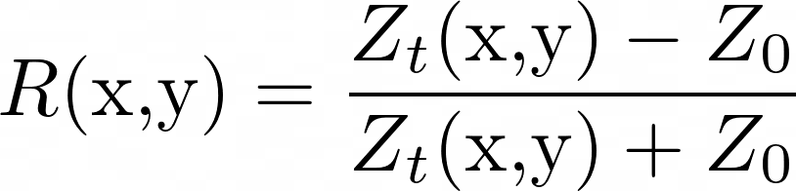
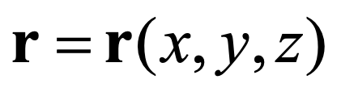
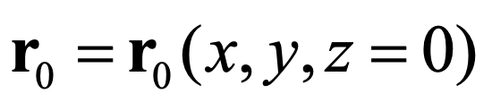
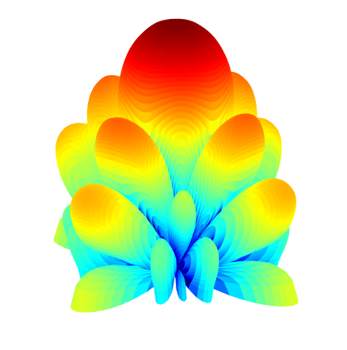
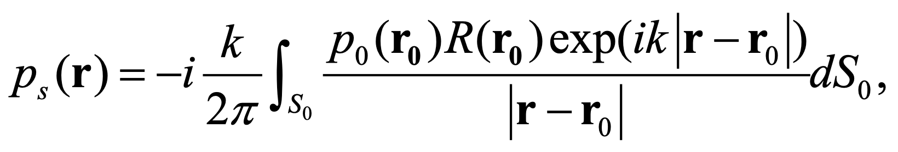
Methods
Model of unit cell
Clamped square elastic plate backed by a cavity
Cavity impedance
Total cell impedance
Reflection coefficient
Scattered acoustic field at point , where
Rigid panel
8

Slide 9
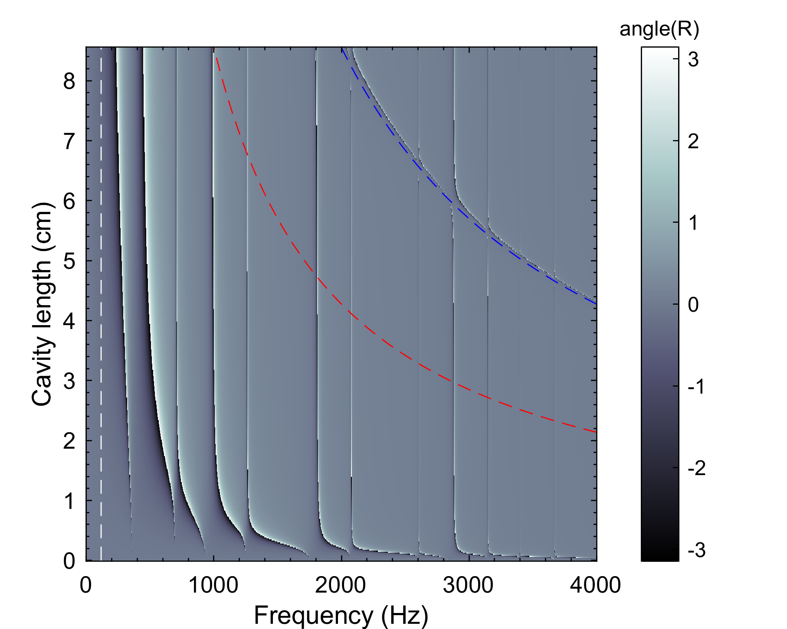



Results
Phase of the reflection coefficient
Dashed blue: antiresonance of the cavity.
Dashed red: resonance of the cavity.
Dashed white: resonance of the plate.
9

Slide 10
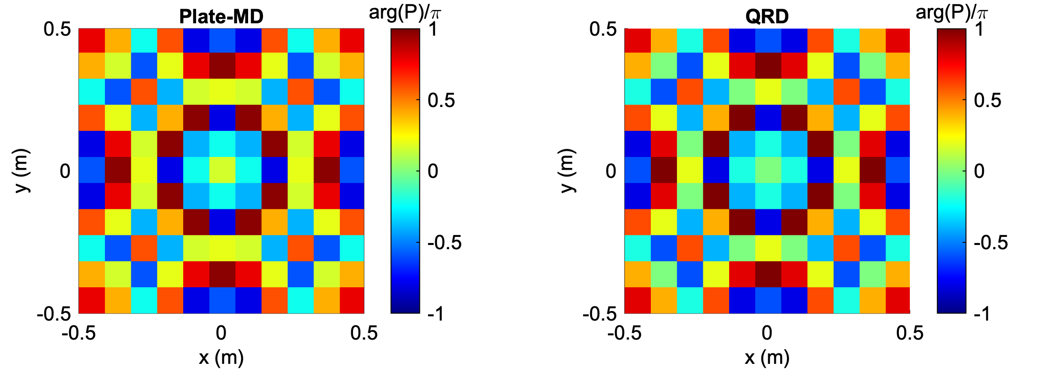
Results
Tuning the reflection coefficient
Design of a plate metadiffuser (Plate-MD) and a QRD diffuser for a working frequency of 1200 Hz.
10

Slide 11

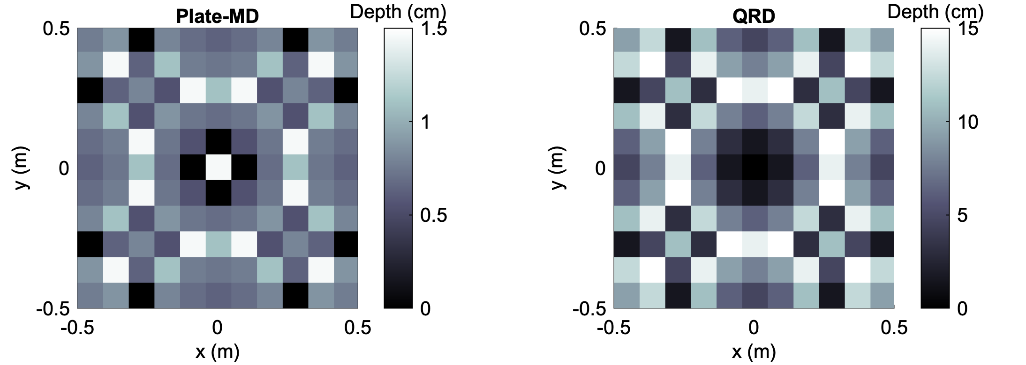

Results
Tuning the reflection coefficient
Design of a plate metadiffuser (Plate-MD) and a QRD diffuser for a working frequency of 1200 Hz.
The plate metadiffuser has the same phase of reflection coefficient but the thickness is about 10 times thinner.
10

Slide 12
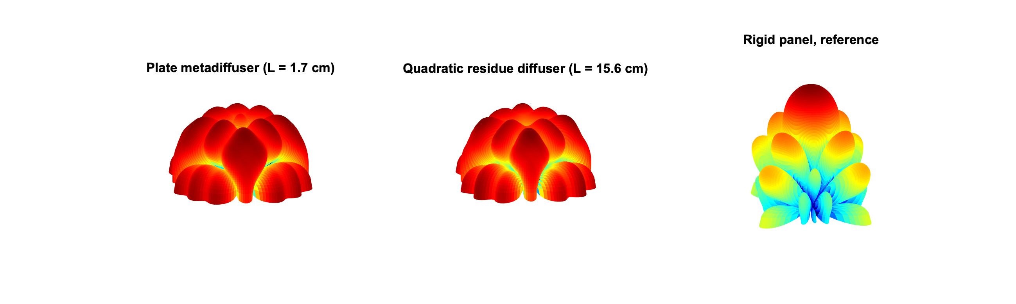
Results
Tuning the reflection coefficient
Design of a plate metadiffuser (Plate-MD) and a QRD diffuser for a working frequency of 1200 Hz.
The plate metadiffuser has the same phase of reflection coefficient but the thickness is about 10 times thinner.
Resulting far-field scattering is the same in both diffusers.
11

Slide 13



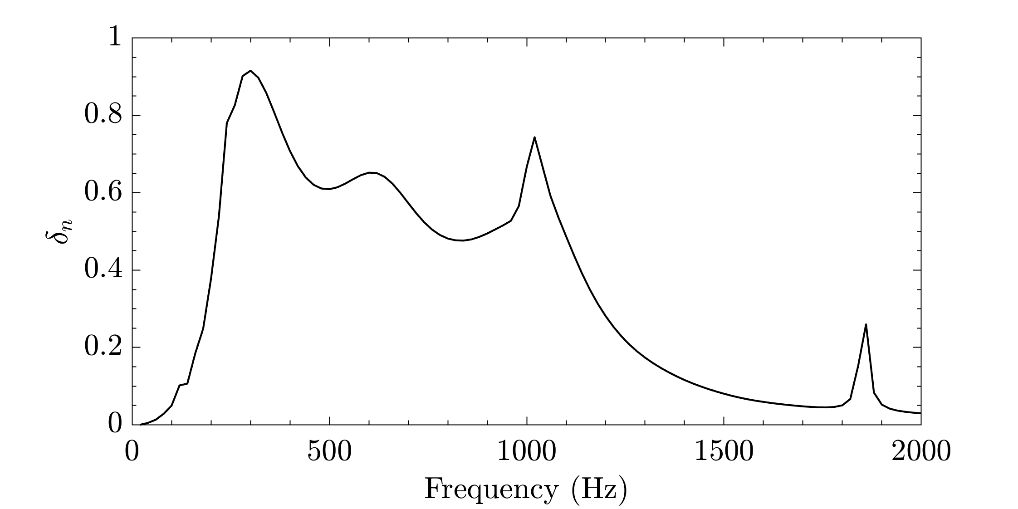
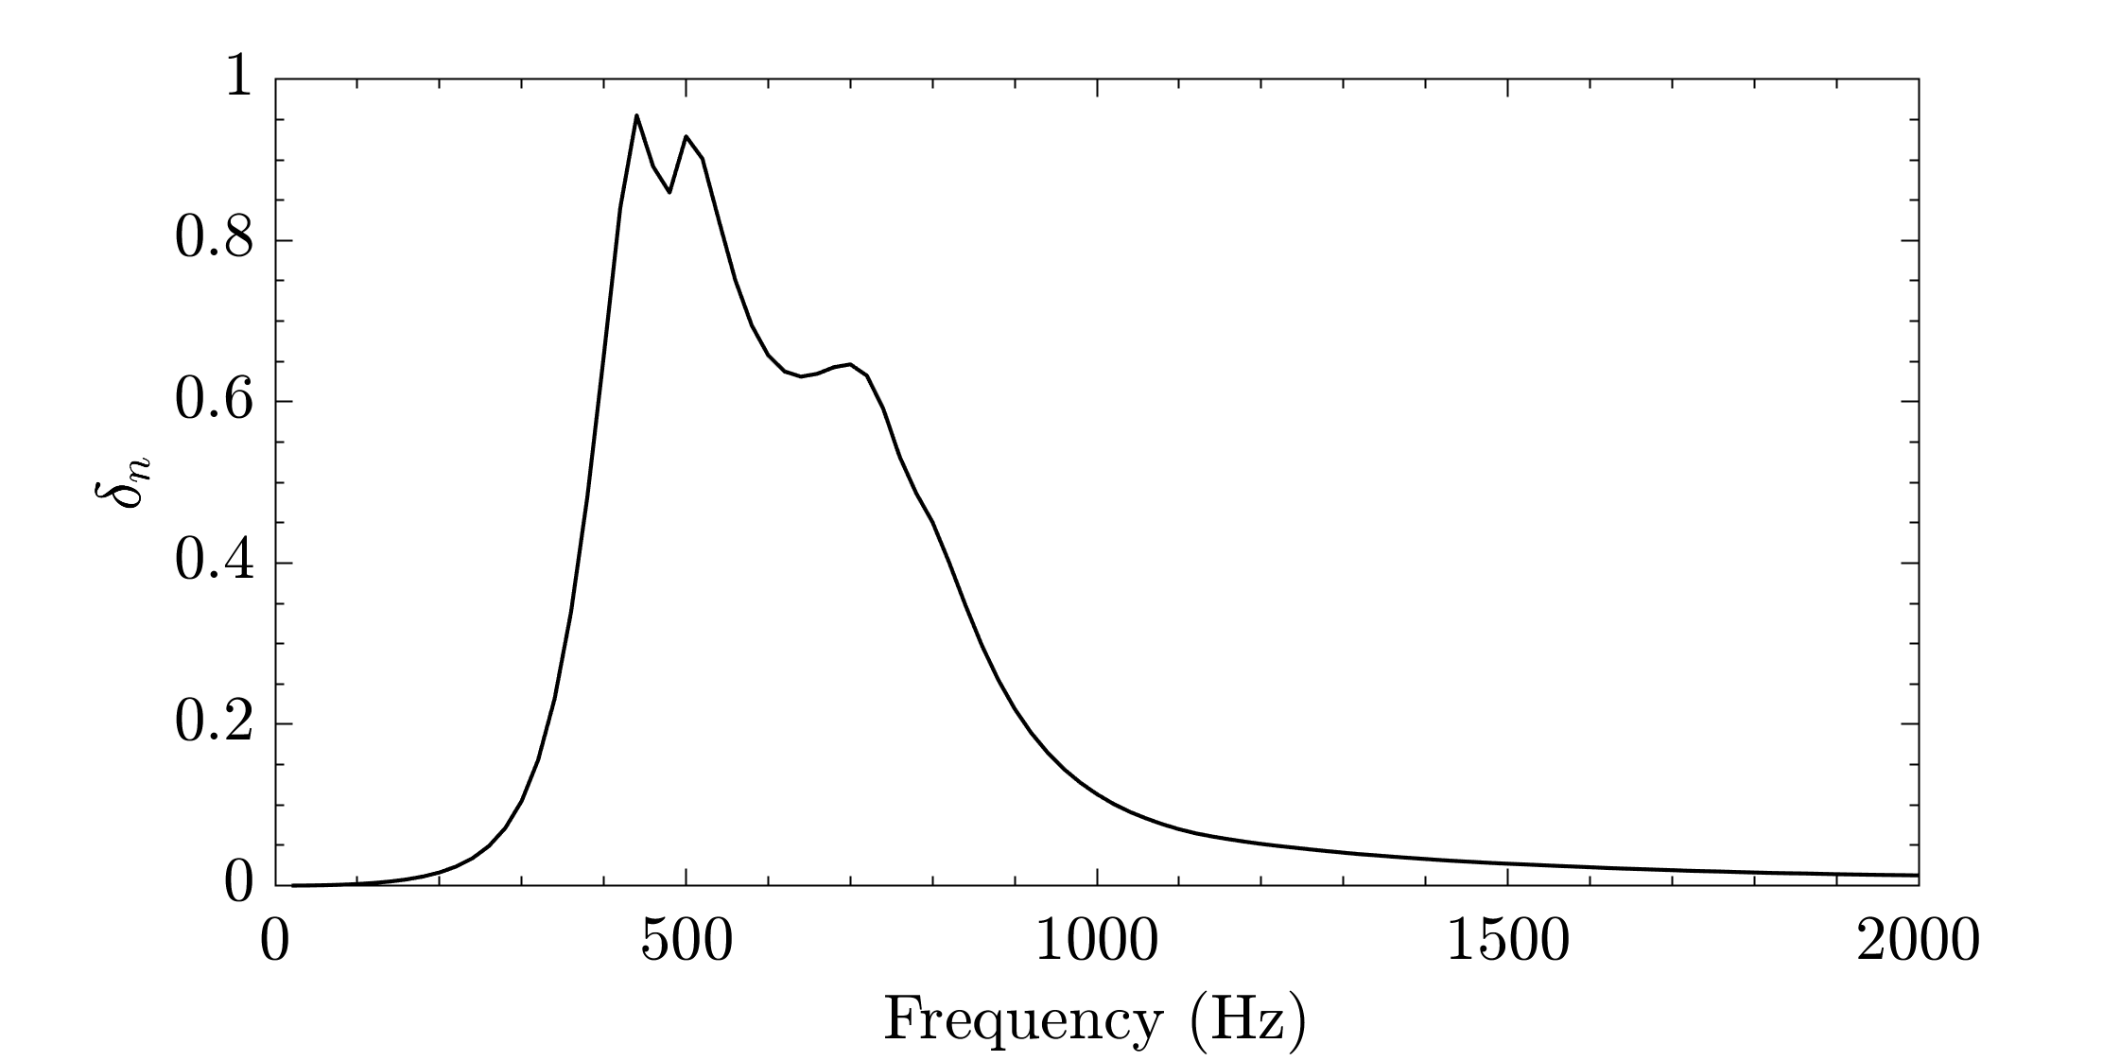
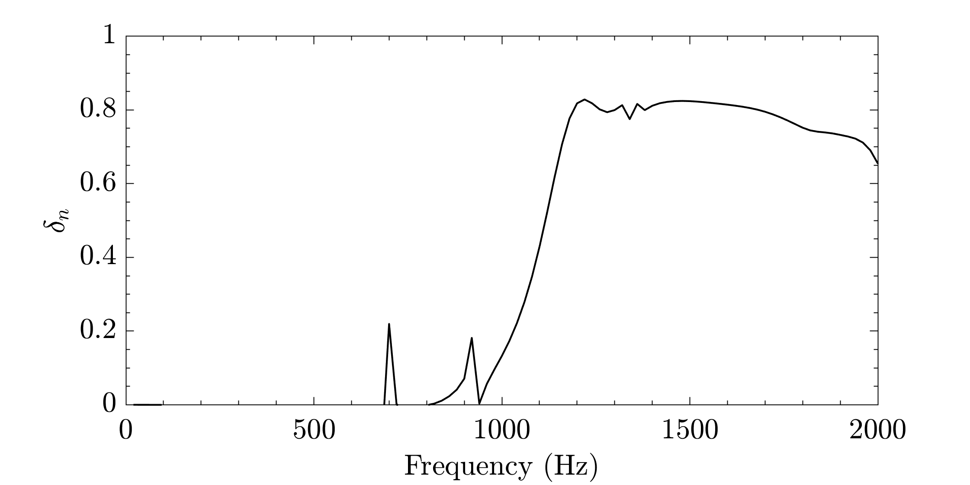
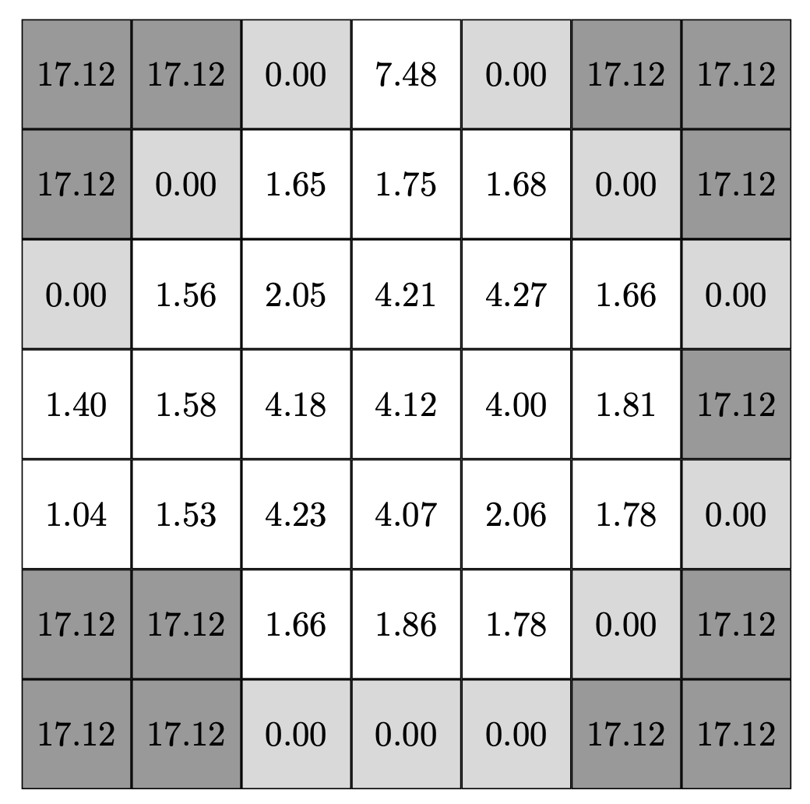
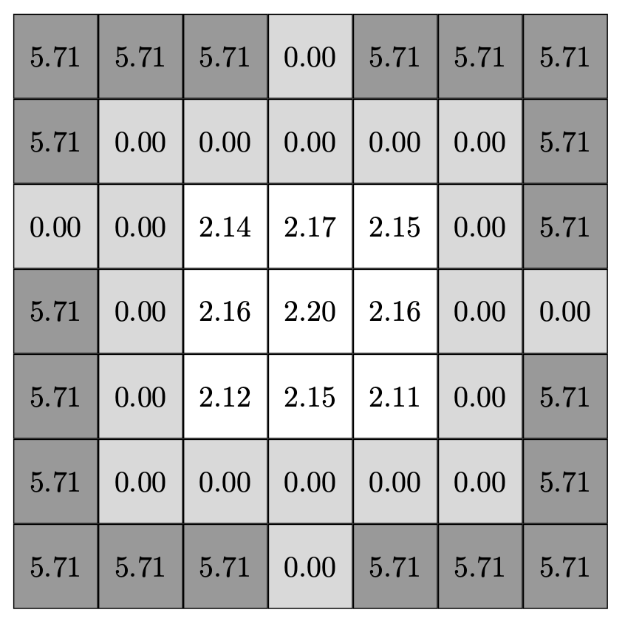
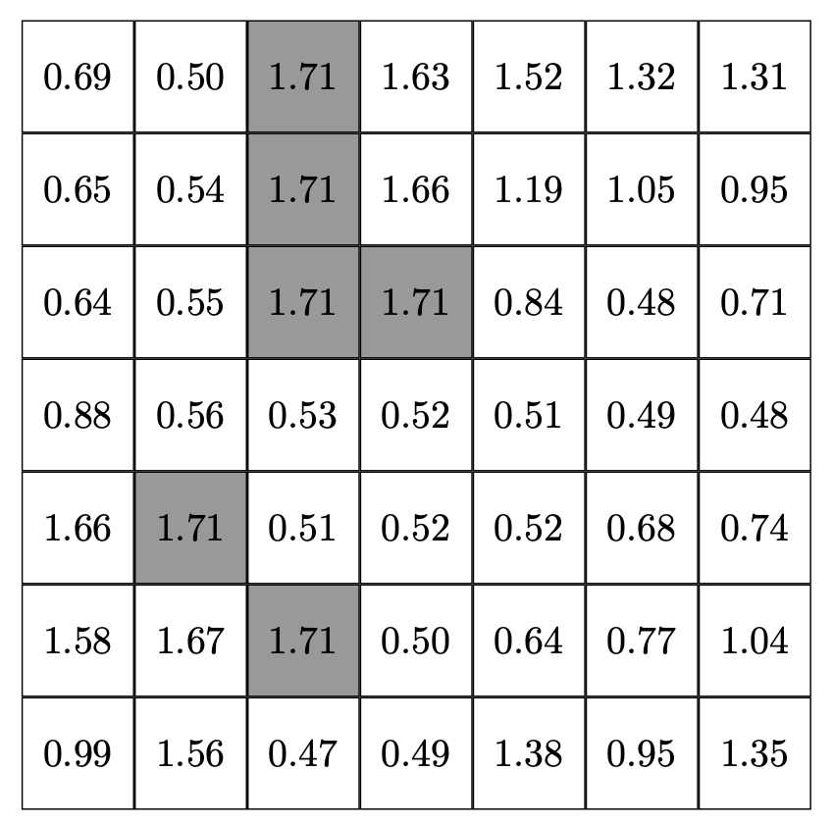
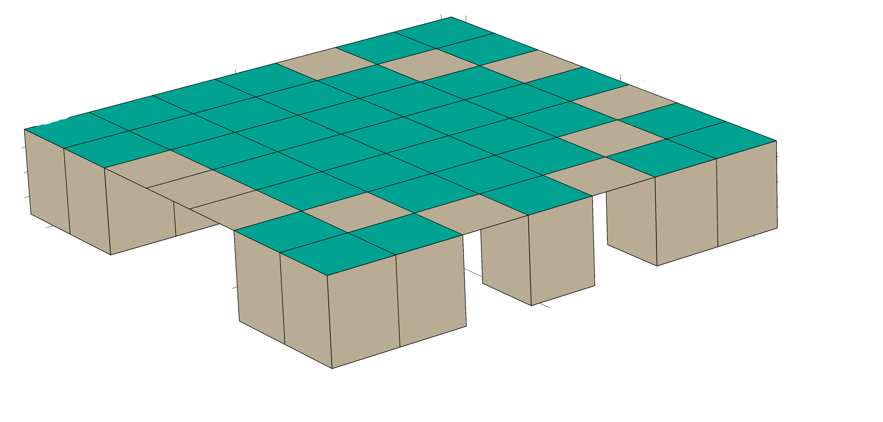
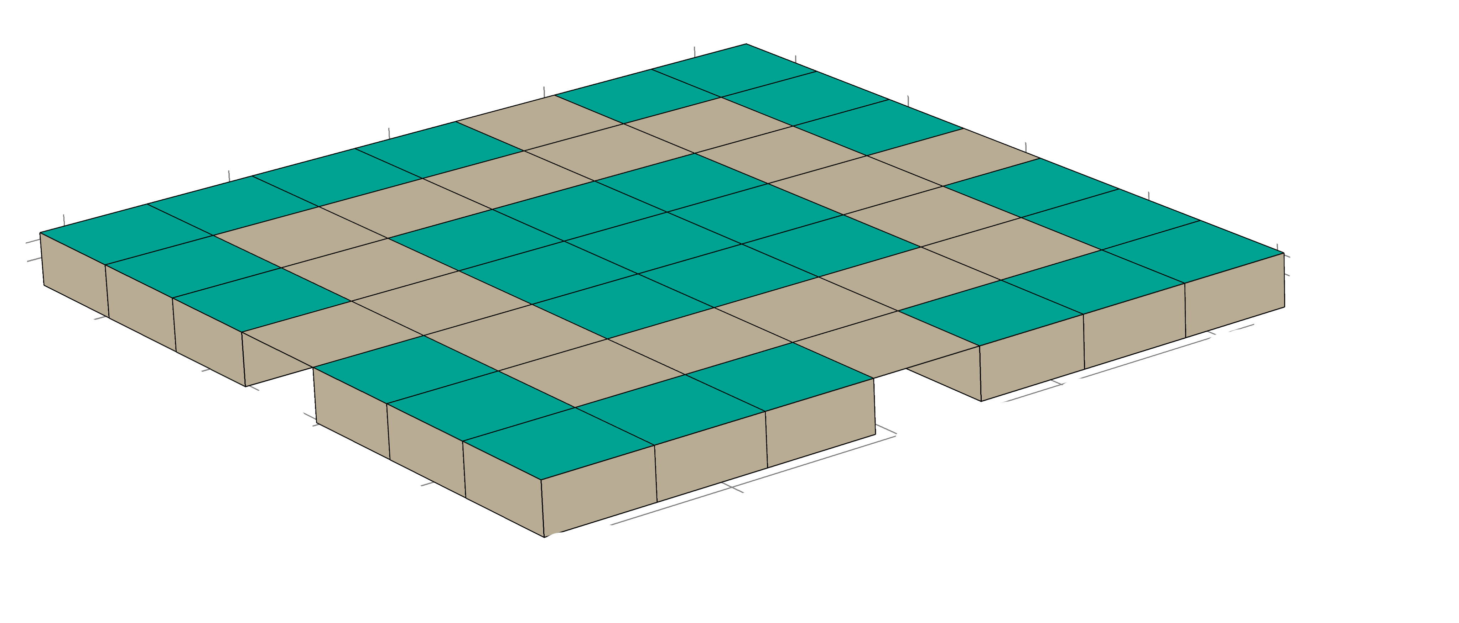
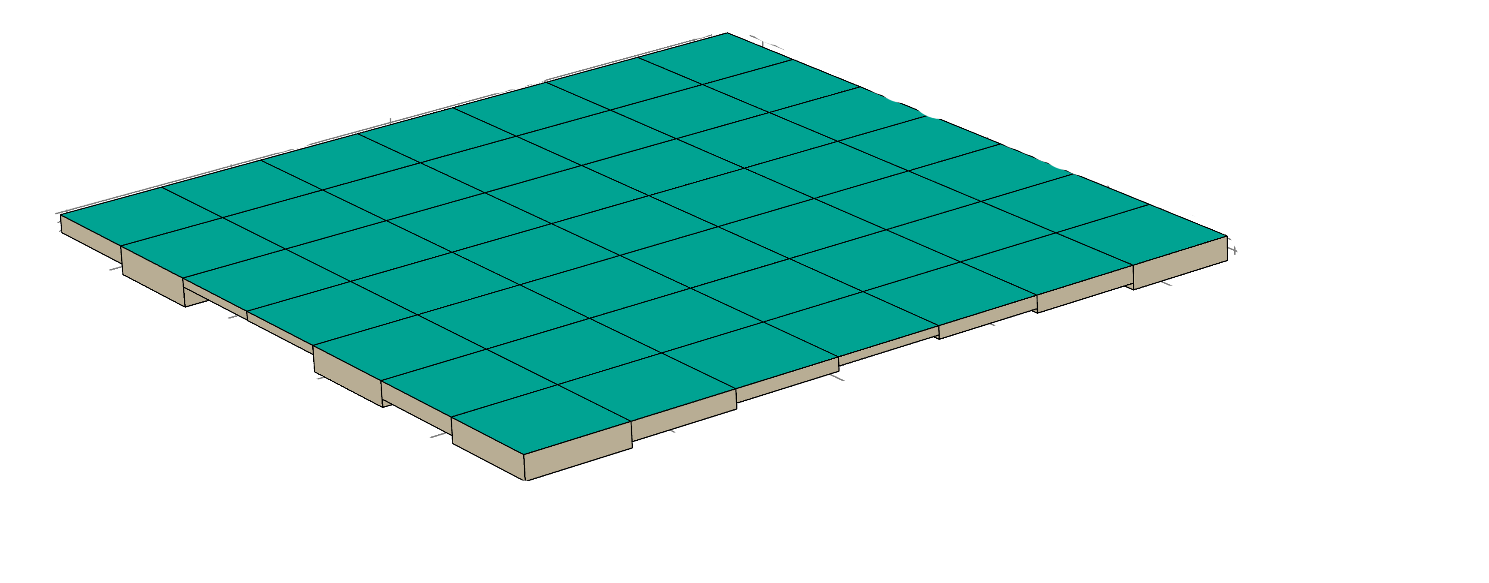
Results
Optimized panels
12

Slide 14
Conclusions
Using plate resonators panels with broadband response can be optimized.
As the bandwidth of the resonance is narrow, the diffusion coefficient should present a band-limited response.
We expect a performance decrease of optimized panels in realistic situations.
Other topologies can be explored to mitigate decreased performance.
This works opens new paths to design shallow panels to control the scattering of acoustic waves.
13

Slide 15
SOUND DIFFUSING METASURFACES BASED ON ELASTIC PLATES AND MEMBRANES
DIFUSIÓN DEL SONIDO CON METASUPERFICIES BASADAS EN PLACAS ELÁSTICAS Y MEMBRANAS
October, 2021.
José M. Requena-Plens¹, Jean-Philippe Groby², Vicent Romero-García², Noé Jiménez¹
¹ Instituto de Instrumentación para Imagen Molecular, Universitat Politècnica de València - CSIC, València, Spain
² Laboratoire d’Acoustique de l’Université du Mans (LAUM), UMR 6613, Institut d'Acoustique - Graduate School (IA-GS), CNRS, Le Mans Université, Le Mans, France

